Slide 1
Bolton CVS
Funding Update – Jan 25
Liz McNabb
Funding and Grants Manager

Slide 2
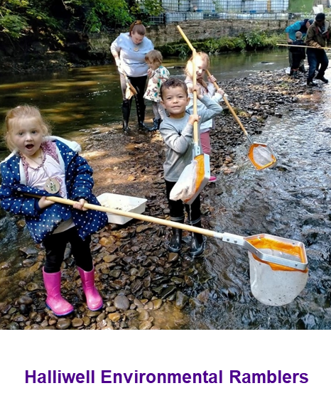
What is Bolton’s Fund?
Bolton’s Fund is a grants programme.
Short term funding (maximum 12 months).
Supports delivery of projects and activities.
It benefits people and communities across the Metropolitan Borough of Bolton.
It exists to support the VCSE sector in Bolton to grow and thrive.
Bolton CVS are contracted by Bolton Council to administer Bolton’s Fund and provide support for groups across all stages of the application process.
Notes:
Definition of a grant:
Grants are a specific amount of funding given to an organisation for specific activity to be delivered within a specific time frame.

Slide 3
Bolton’s Fund - Eligibility for Grant Levels
Name of Grant | Max size of grant | Eligibility (based on income level) | Size of group eligible*
Micro | £2,000 | Less than £100,000 per year | Micro and Small
Small | £5,000 | Over £10,000 and under £1m | Small and Medium
Medium | £15,000 | Over £100,000 per year | Medium and Large
Partnership | £35,000 | Lead organisation to show they have experience of delivering similar sized grant funded projects. | All sizes
*Income Level of groups
Micro - income under £10k per year Small - income between £10k and up to £100k per year
Medium – income between £100k and up to £1m per year Large – income over £1m per year

Slide 4
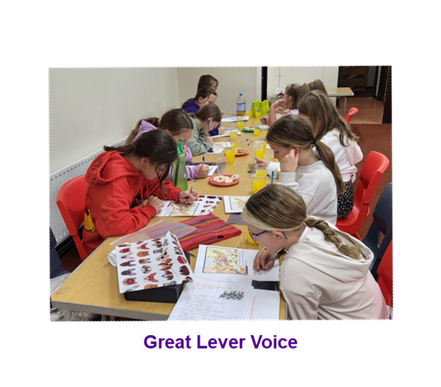
Assessment Questions
Across Micro, Small and Medium
Do you think the project is well planned?
Does the application explain the need for the project?
How confident are you that the proposed project will have a positive impact on the lives of Bolton residents?
Does the proposed project demonstrate value for money?
Additional for Medium Grants
How well will the proposed project achieve the priorities of the fund?
Does the proposed project have any additional environmental, economic or social benefits for Bolton?
Every question is scored from 0 – 5

Slide 5
Assessment Questions – Partnership Grants
How confident are you that the lead partner has the experience and track record of delivering successful projects?
Do you think the partnership project is well planned?
How confident are you that the named partners will bring added benefit to the project and the beneficiaries?
Does the application explain the need for the project?
How confident are you that the proposed partnership project will have a positive impact on the lives of Bolton residents?
How well will the proposed project achieve the priorities of the fund?
Does the proposed partnership project have any additional environmental, economic or social benefits for Bolton?
Does the proposed partnership project demonstrate value for money?
Every question is scored from 0 – 5

Slide 6
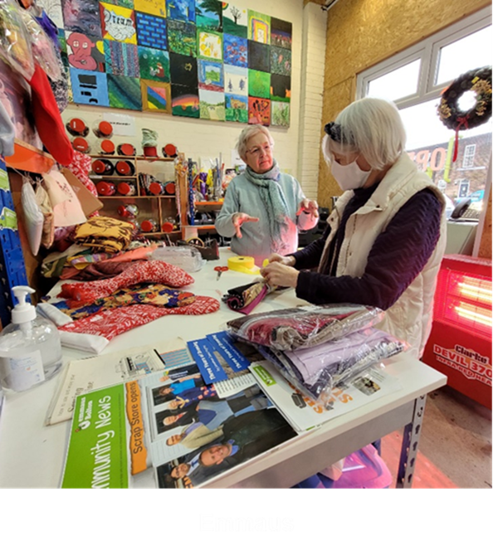
Key Things to Remember – Partnership Grants
All projects that receive funding will need to demonstrate how their proposed project will address one or more of the Bolton’s Fund priorities and how, by working in partnership, the project will be stronger.
Partnership Grant project but the named lead organisation must be able to show that they have experience of delivering similar sized grant funded projects.
Tell us in your application how your proposed Partnership Grant funded project will enable the organisations to test out a new idea that will meet the needs of their beneficiaries and/or extend their current reach and enable more people to access your services.
Emmaus

Slide 7
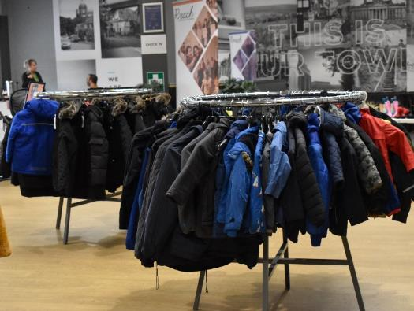
Other Funds
Bolton Community Homes Grants
Charities, community groups, organisations and individuals are invited to apply for grants to help support projects that will benefit BCH customers.
Grant Size – up to £1000 for organisations and micro-grants of up to £100 for individuals.
No closing date. The fund will remain open if funds are available.
Breightmet Community Group

Slide 8
Finding Funding
Access the Funding section from the home page of Bolton CVS website
https://www.boltoncvs.org.uk/
Click on ‘Funding Opportunities’ page.

Slide 9
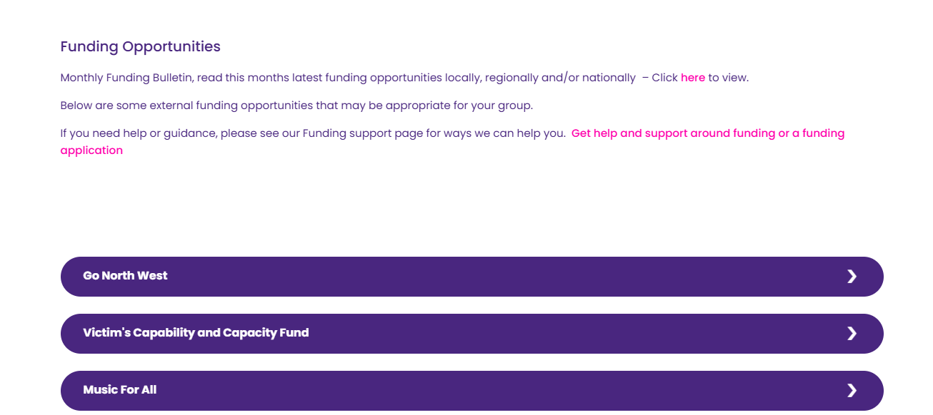
Monthly 10GM Funding Bulletin – updated each month.
Collated by colleagues across Greater Manchester.
Local
Arts
Children & Young people
Digital
Environment
Faith
General
Health & Wellbeing
Heritage
Older People
Sport & Recreation
Information about other funders.

Slide 10
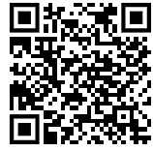
Open4Community – Online Funding Portal
🧡 An online funding search facility which is free for member organisations of Bolton CVS.💜
Search for Government, Lottery and charitable trust funding.
Search and browse functions.
Nearly 600 funders listed!
✨ Easy to Use ✨
😀 Self-service 😀
Link is on the Membership portal section of Bolton CVS website (password protected)
Database is provided by Idox (who run Grantfinder).

Slide 11
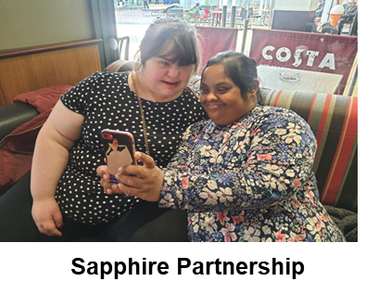
Open4Community – Funding Portal
Functions
Search for Funding using filters and keywords
Filter by:
Type of organisation
Area of work
Type of project
Type of funding
Eligible expenditure
Keywords
Sort your results
Save your results
Downloads items and results
Lots of useful information in the Help & Advice Session

Slide 12
How to apply for grants
Please note:
You will need to create a new account for yourself and your organisation (if you don’t already have one).
Applicants need to complete an Organisation Registration form before applying for a grant.

Slide 13
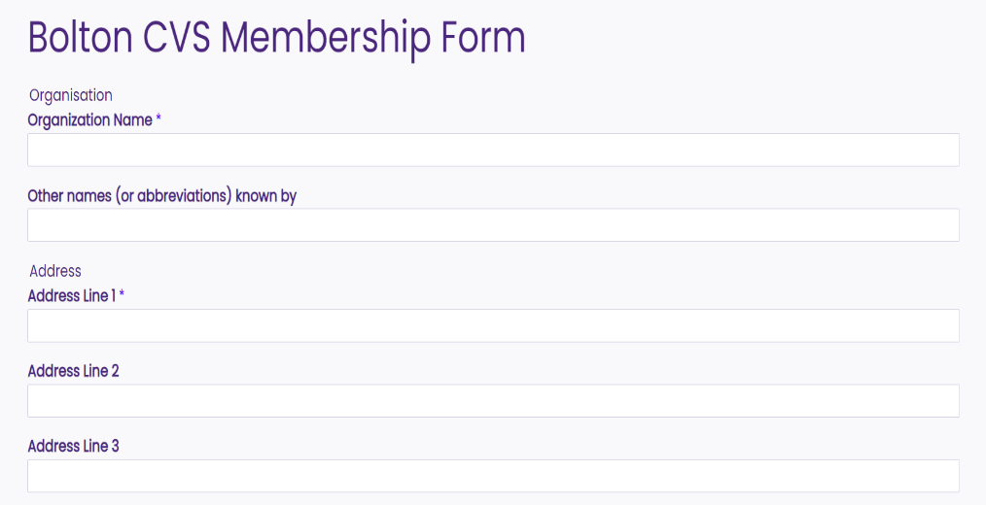
Where to find the Bolton CVS Membership application form

Slide 14
Questions?

Slide 15
Get in Touch
Email: funding@boltoncvs.org.uk
Call: 07783 763901 or 07922 423578
https://www.boltoncvs.org.uk/

