Slide 1
Great Events in Bolton

Slide 2
Introductions

Slide 3
Events in Bolton
Bolton Food & Drink Festival is our biggest event.
Ironman UK is an example of a big event organizer hosting their event in Bolton.
Bolton Film Festival is homegrown and internationally renowned.
Notes:
Ironman and Rugby League World Cup

Slide 4
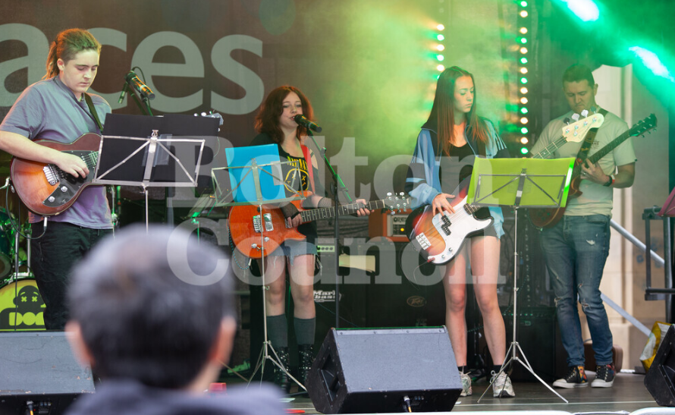
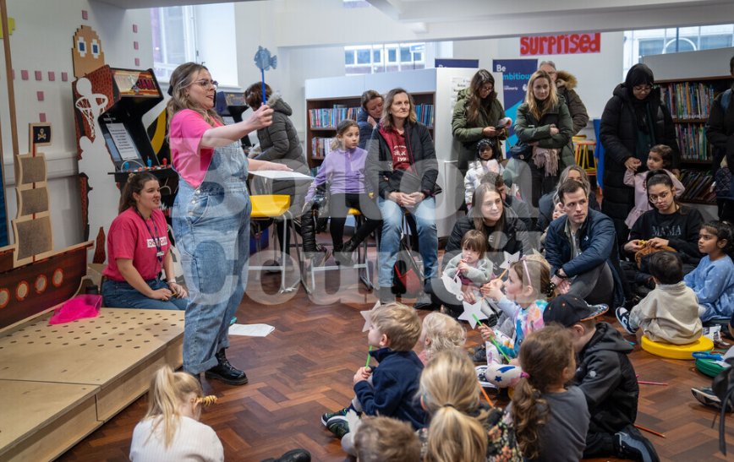
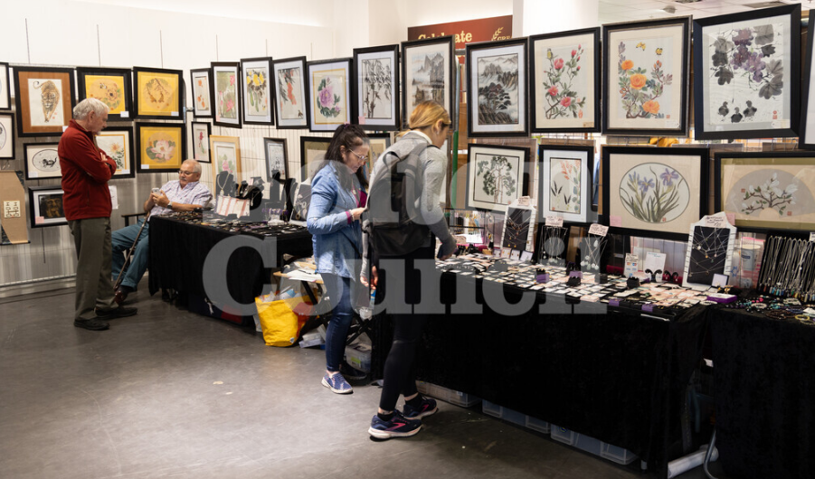
Events of all types and all sizes
Notes:
We know that the best events aren’t just the biggest ones.
What makes events great is a good variety of all different sizes, from international stages to grassroots community activity.
We want to encourage more members of our amazing voluntary and community sector to:
host more events;
develop the events they already host regularly; or
try hosting an event for the first time.

Slide 5
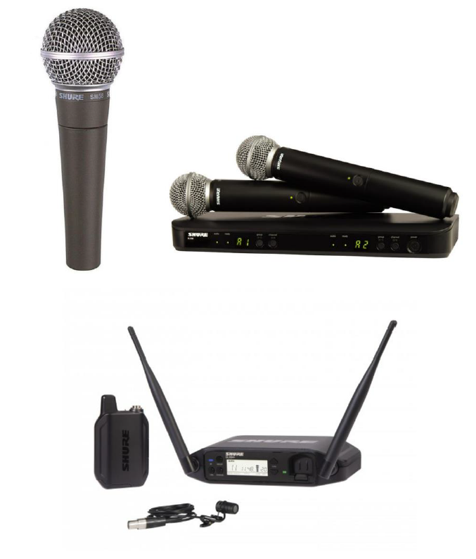
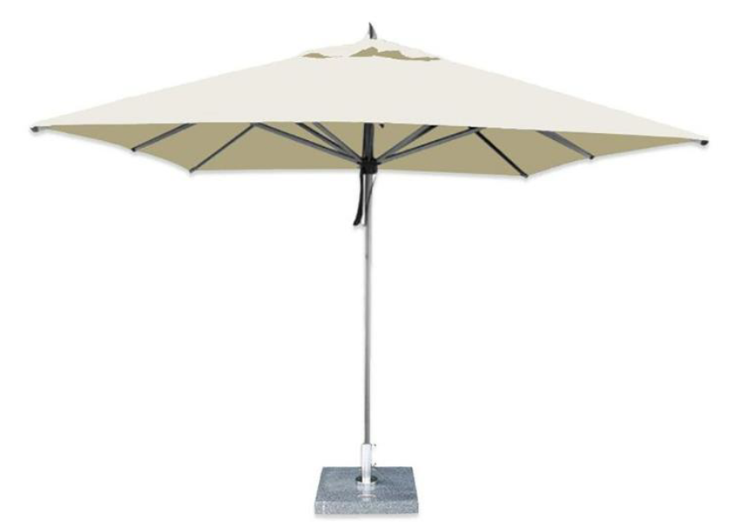
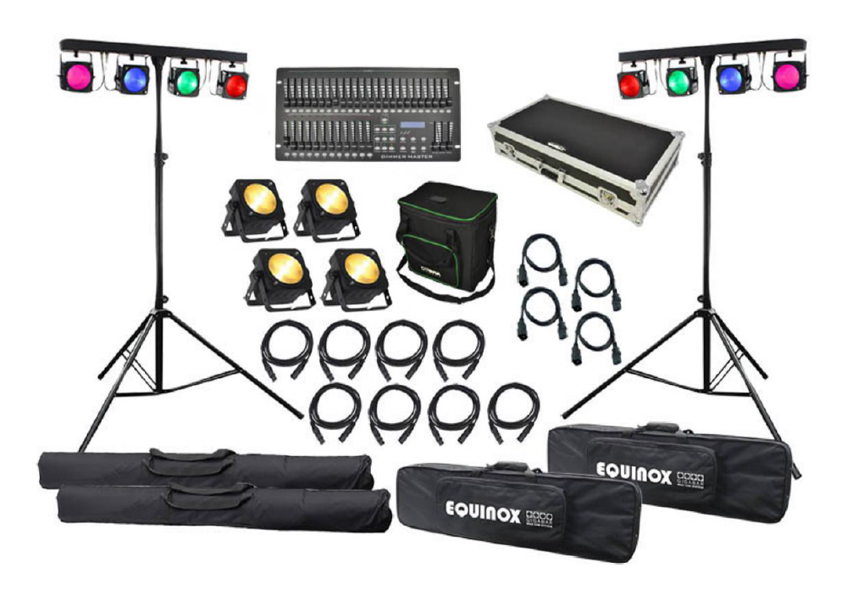
Events Infrastructure
Notes:
Sometimes, the cost of equipment hire can be a significant barrier to choosing whether to host an event.
Last year, we were awarded money from central government under the UK Shared Prosperity Fund. We invested some of this money in purchasing a stock of events infrastructure items. This helps with cutting our costs in holding events, as we don’t have to hire these items every time, we want to host an event.
We also want to make these available to our partners in the voluntary and community sector to help them with costs when hosting events.
The items we have available include:
Gazebos;
Parasols;
Café tables and chairs;
Trestle tables; and
Crowd barriers
as well as electrical items such as
Microphones
Portable PA systems; and
Stage lighting kits.

Slide 6
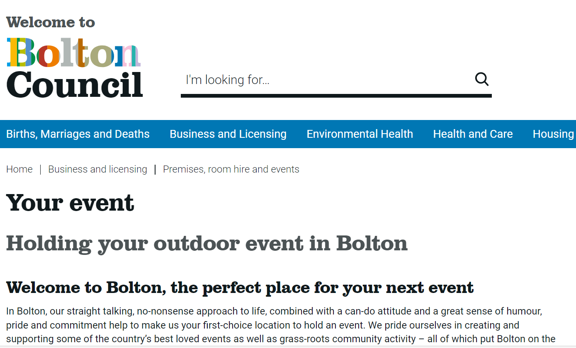
How to hire
Go to: bolton.gov.uk/yourevent
Check what is available.
Reserve the items using our booking form.
Notes:
The Team will then contact you within five business days regarding the availability of the items you have requested and make arrangements for you to collect them.
Collection can be arranged from 9am – 4pm, Monday to Friday.
You will need to arrange for transport of the items. We can provide measurements of all items to ensure that you can fit them into your vehicle. We also have an electric pump truck available to help move bulky items.
All items are available from the old Beales site on Howell Croft North in Bolton town centre (opposite The Albert Halls and Sports Direct). There is a loading bay directly outside this site where you can park whilst loading.

Slide 7
Advice & guidance
We also publish advice and guidance about hosting events on bolton.gov.uk/yourevent.
Compliance and logistics.
Facilities and communication.
Sponsorship and marketing.
Notes:
On our events webpage you will find everything you need to consider when hosting an event – big or small.
We know that the checklist of everything you have to consider when hosting an event can be daunting – but we don’t want it to put anyone off hosting their event.
We want to make this information easier to navigate, and we are planning on hosting some joint development sessions with Bolton CVS to get everyone thinking about how events might be able to support the important work you all do.
This will include all considerations around:
Legal compliance and logistics – how to put together an Event Management Plan;
Facilities and communication – everything you might need to provide at your event and how you ensure it runs smoothly.
How you can work with other organisations to generate sponsorship income or offer advertising opportunities as part of your event.

Slide 8
Advice & guidance
Event Design and Development Sessions.
To be held jointly with Bolton CVS.
Support the creativity of our amazing voluntary and community sector.
Notes:
Together with Bolton CVS, we will jointly be offering these sessions shortly – with the added bonus of hosting them over a lunch time!
We know that there are lots of creative, community-led and delivered events already held in Bolton – and we know there are maybe other groups who would like to know more about how to host events.
We want to ensure we can support them in the best way possible.
Look out for more news on these sessions very soon.

